Slide 1
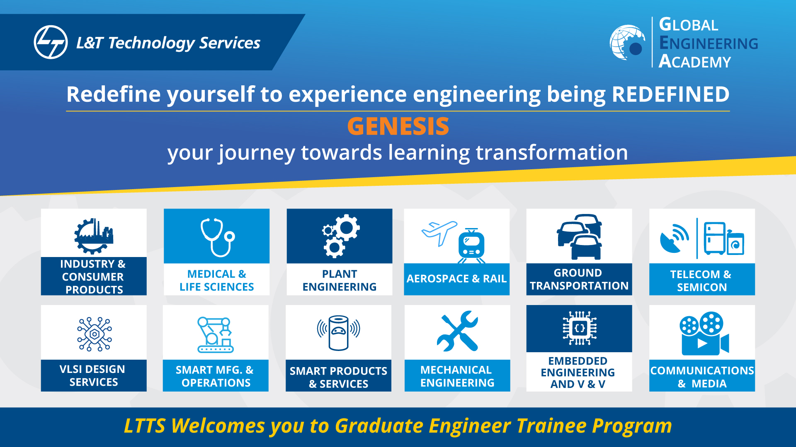

Slide 2
Project Highlights
Project Name : Genesis Trainee Registration using c#
Team Size : 4
BU Mentor Name : Mentor PS#
Team Members Details (Professional Stamp Size Photo with few lines of individual briefing

Slide 3
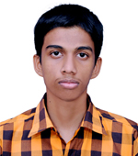
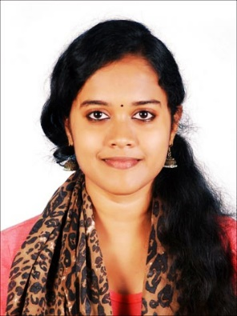
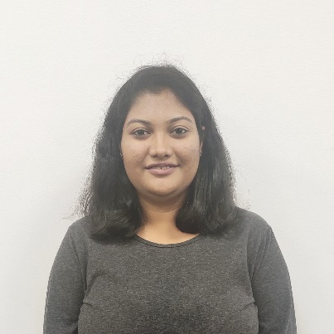
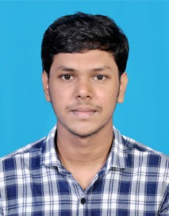
Subin Suthan
99002640
2009MYSSPSB1
B.Tech in Computer Science and Engineering
C++, Python, ML
Aneena Fernandez
99002650
2009MYSSPSB1
B.Tech in Computer Science
Python, C++
Chandana AN
99002674
2009MYSSPSB1
B.E in Information Science and Engineering
Oop, C++, Python
Pradeep CV
99002647
2009MYSSPSB1
M.Tech in Computer Science
C, C++, Java

Slide 4
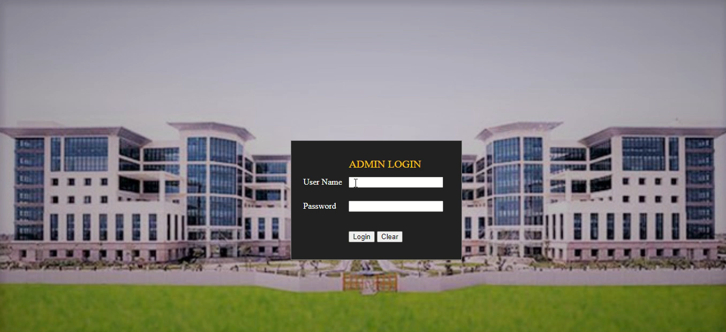
Project Video Snippet

Slide 5
Future development that can be implemented further
Using Cloud Data base services such as AWS, we can improve query speed drastically and enhance scalability.
Adding search operation to search a large list of details, based on Indexing
Planning to add access to contents like Video, study materials for each course with a click of a button
Using NoSql like Mongo DB for performance

Slide 6

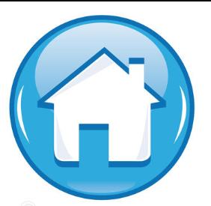
Thank You !

